Slide 1

How to use Microsoft Forms

Slide 2
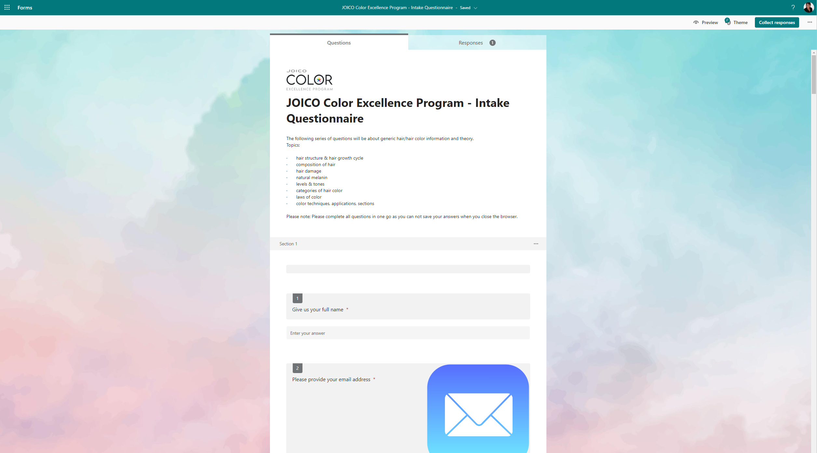
This is what you see when you use the QR code or link

Slide 3
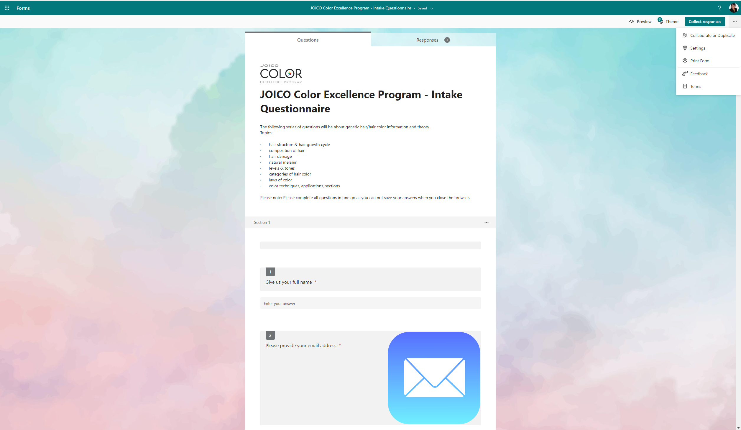
Click on … in the corner and click on Collaborate or Duplicate

Slide 4
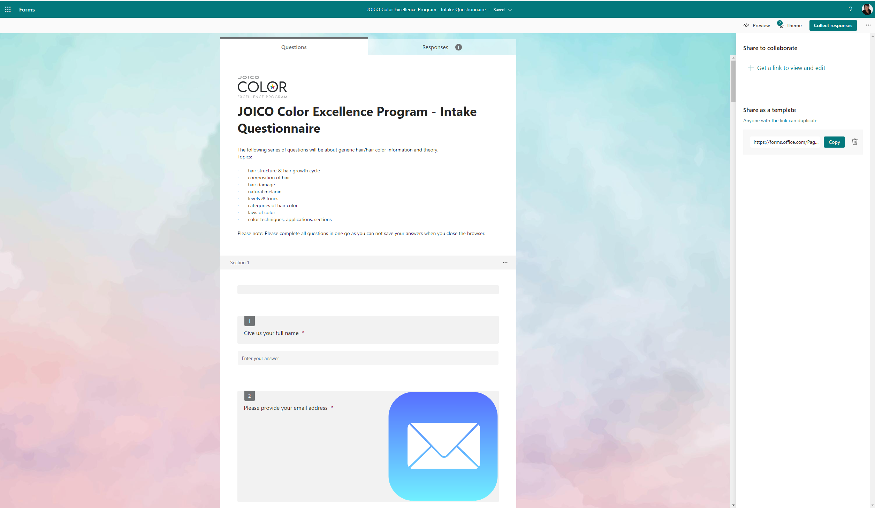
Click on … in the corner and click on Collaborate or Duplicate

Slide 5
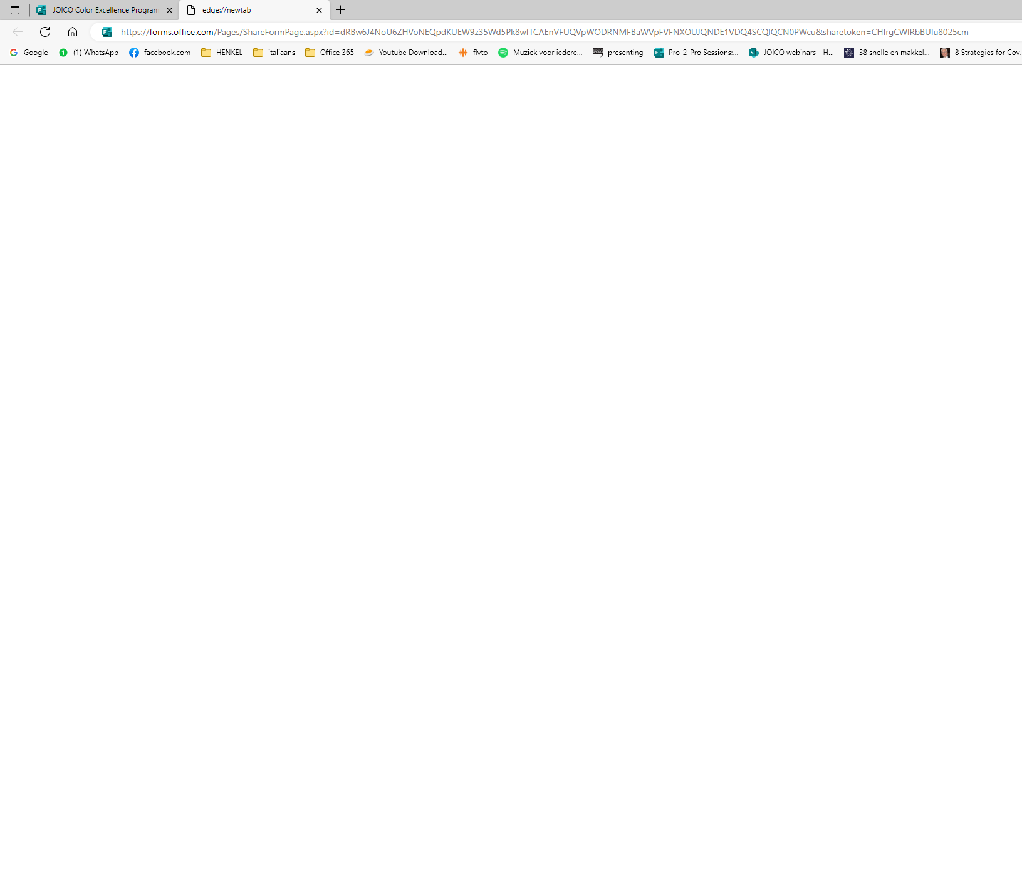
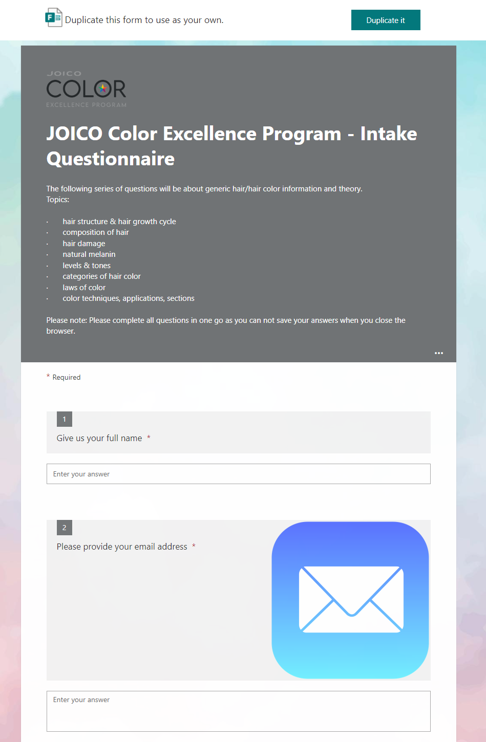
Paste the link in your browser and when you see this, click on duplicate it

Slide 6
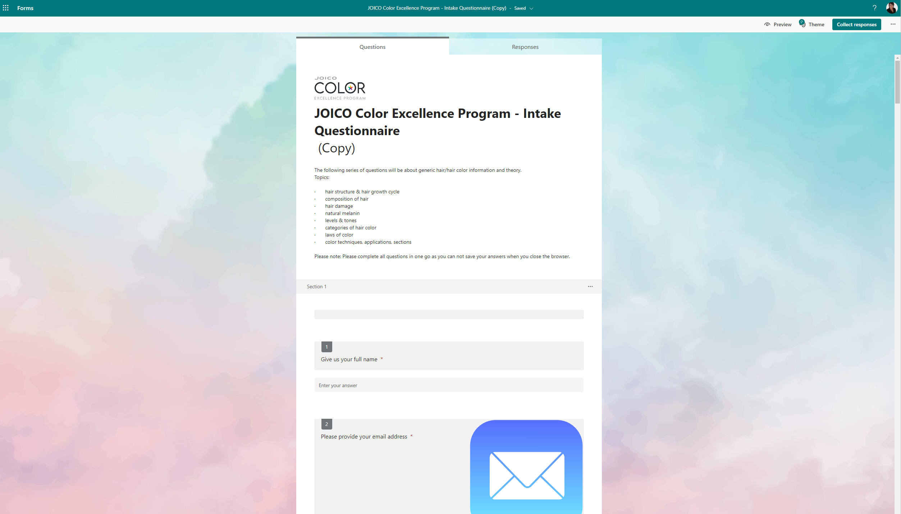
You will notice the word “Copy” in the title. Click on the title and remove the word Copy and start your translation

Slide 7
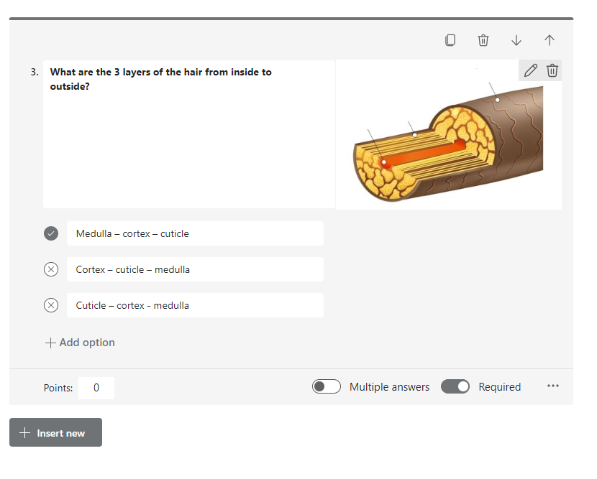
By clicking on the text, you are able to translate into your own language.

Slide 8
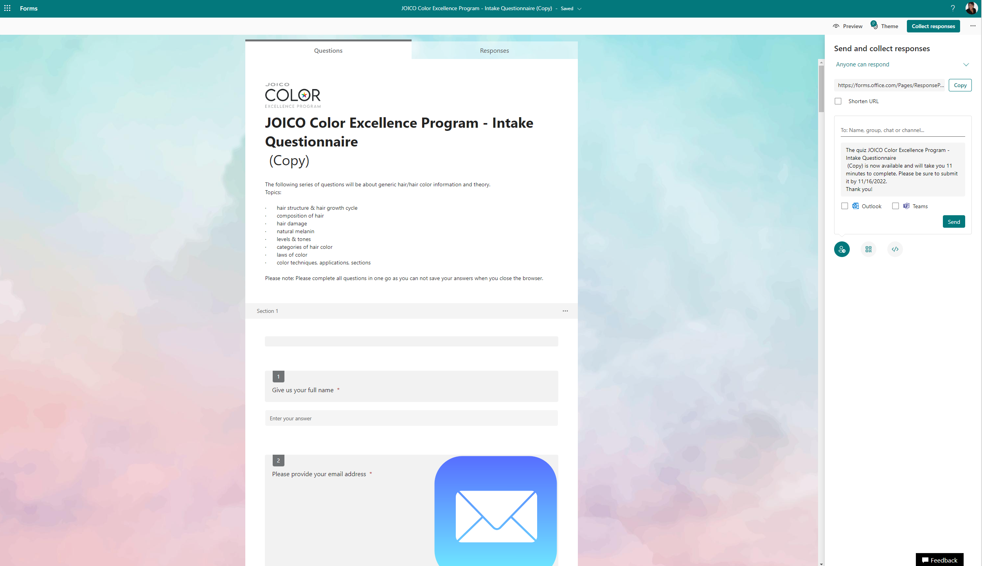
When you are ready, you can press Collect Responses and you will see the following

Slide 9
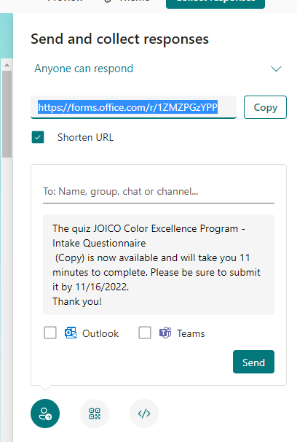
Two options to send the Microsoft form to the participants:
Tick this box to shorten the URL before you copy the link
You can send directly an email to all participant here, make sure to adapt the text
You can create a QR code by clicking here and send this

Slide 10
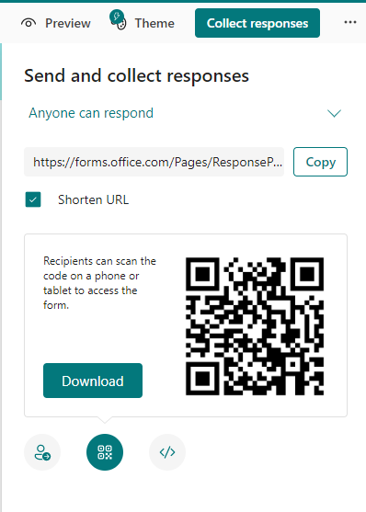
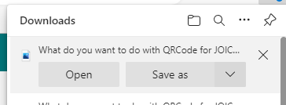
When you create the QR code, make sure you save this first.

Slide 11
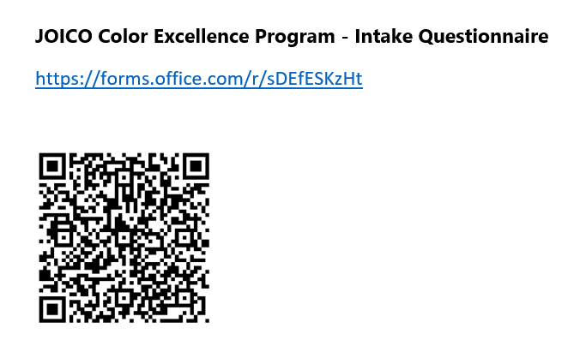
This is an option of how to send it to your participants.

Slide 12
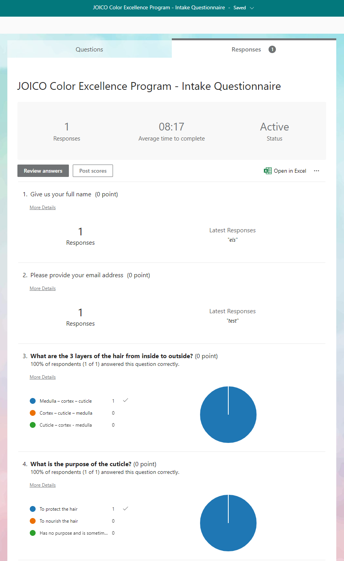
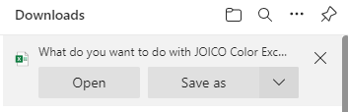
When you get the results in you click on responses
This is what you see.
Click then on open in Excel and save as…

Slide 13
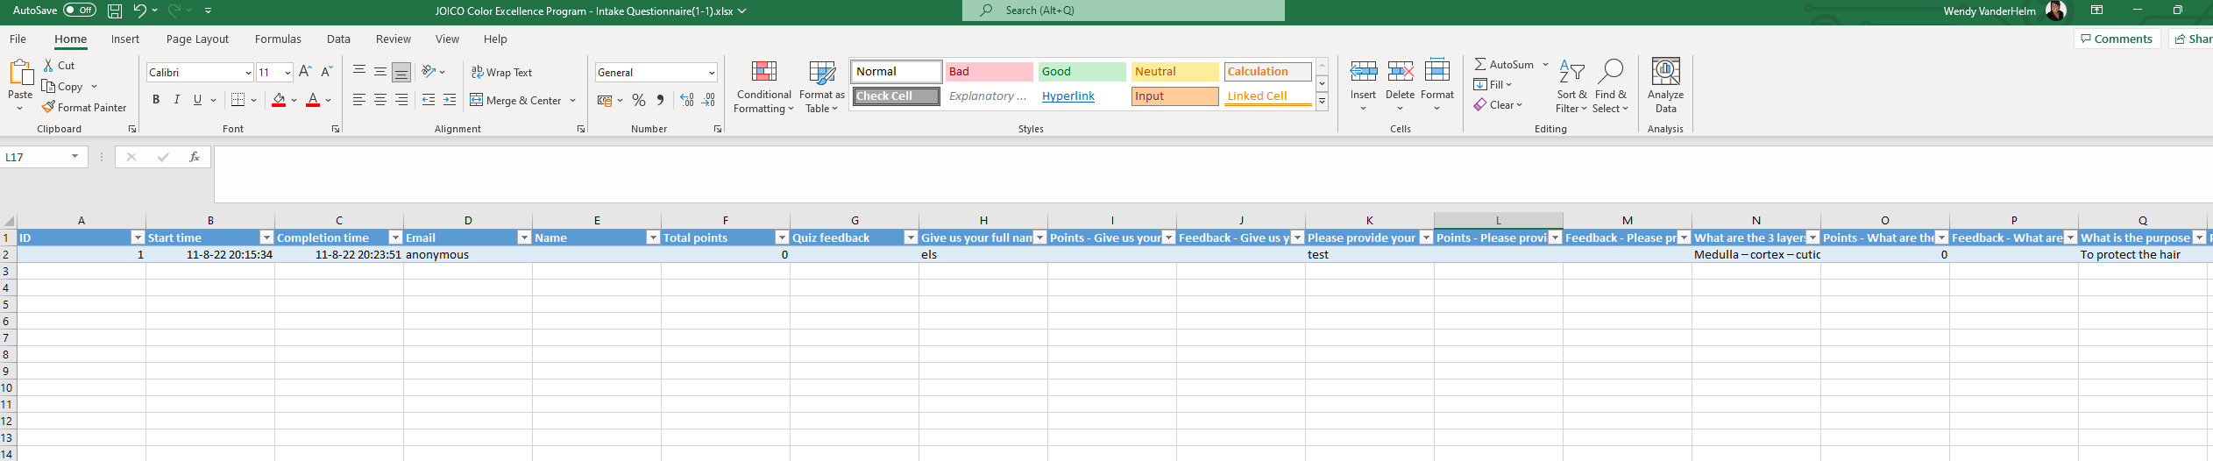
You will get the results in an excel file which you can use to see their replies

Slide 14
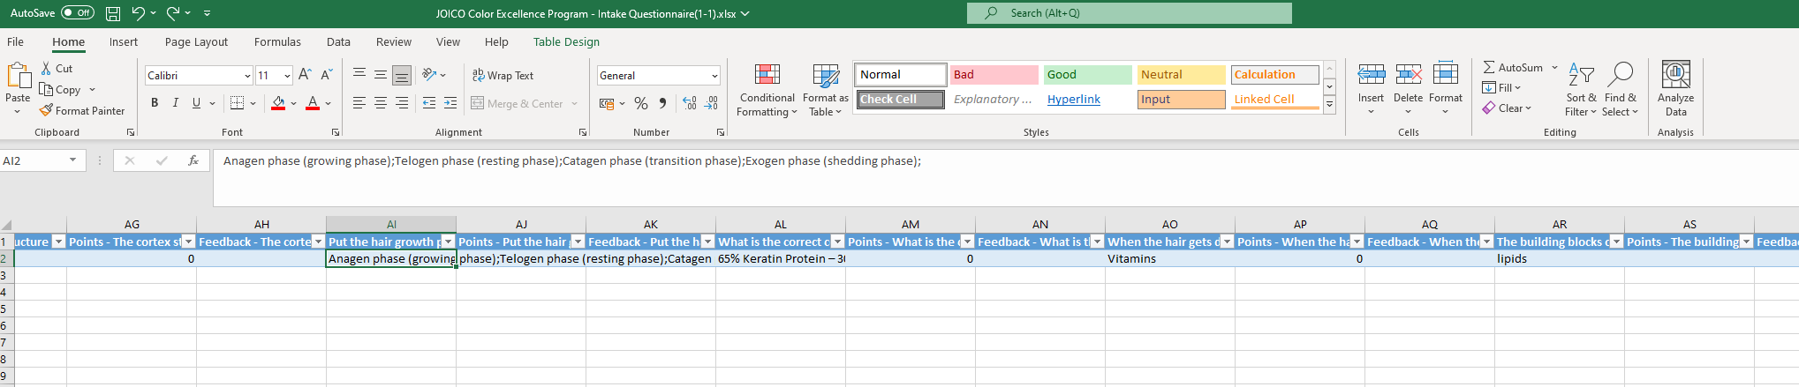
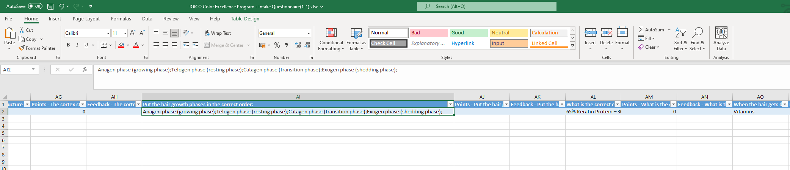
You will see there is more text, by double clicking here your column will get bigger. You can put the points behind the question if you would like to judge them and give them points

