Slide 1



START

Slide 2

What is the ideal
participant

Slide 3

MOVE 2 SPOTS

Slide 4


How many online questionnaires are there in module 2

Slide 5

MOVE 3 SPOTS

Slide 6
What are the
benefits of
for the salon

Slide 7

Take a crazy pose, hold still until it is your turn again. If you move, go back to start.

Slide 8
What are the 3 workshop options
on day 6

Slide 9

Roll the dice again!

Slide 10
How many modules are there in total?

Slide 11
MOVE 2 SPOTS

Slide 12
How many physical days are there in total?

Slide 13

Skip the next turn

Slide 14
What to do when a day is missed due to illness

Slide 15

Roll the dice again but go backward

Slide 16
What are the
benefits of
for the consumer

Slide 17

Go back to

Slide 18
In what ways can you use the workbook

Slide 19

Switch place with the shortest player

Slide 20
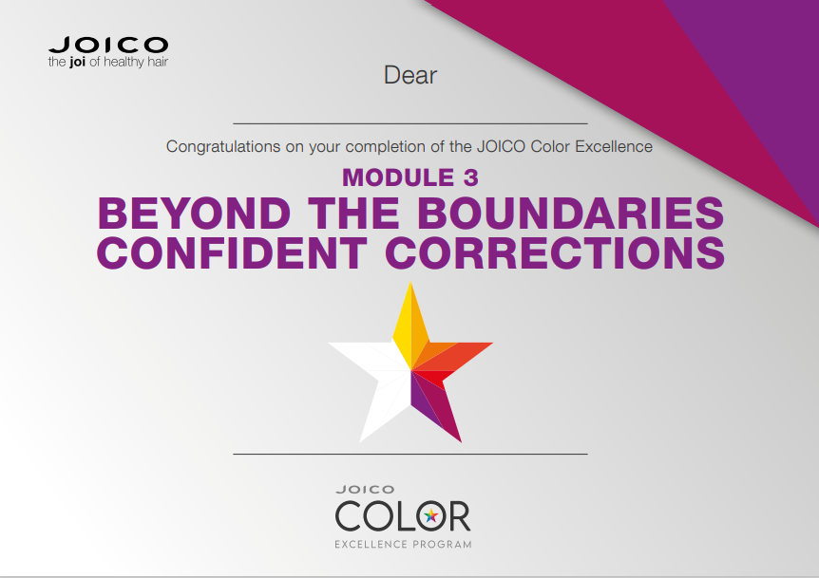
When do you hand out a module certificate

Slide 21

Stand on 1 leg, hold still until it is your turn again. If you move, go back to start

Slide 22

When do you hand out the CE trophy

Slide 23
MOVE 3 SPOTS

Slide 24
What are the
benefits of
for the participant

Slide 25

Switch place with one of your team members

Slide 26
What is the
goal of the intake questionnaire

Slide 27
Switch place with a player of choice

Slide 28
What are the topics of the
pre-blended color insights day

Slide 29

Close your eyes, turn around for 10 seconds. Take 3 large steps in your new direction
10 sec

Slide 30
What are the workshop options
during the magic of pure tone color

Slide 31

Sing your national anthem
Sing = go to finish
Refuse = go back 6 spots

Slide 32

What is the ideal program for the salon owner

Slide 33

FINISH

Slide 34
start
What is the ideal CE participant?
Move 2 spots forward
How many online questionnaires are there in Module 2
Go 3 spots backward
What are the benefits of CE program for the salon?
Take a crazy pose, hold still until it is your turn again. If you move, go back to start
What are the 3 workshop options for Module 3?
When do you hand out the CE trophy?
Move 3 spots backward
What are the benefits of CE program for the participant?
Switch place with one of your group members
What is the purpose of the online intake questionnaire?
Switch place with a player of your choice
Roll the dice again!
Stand on 1 leg, hold still until it is your turn again. If you move, go back to start
What are the topics of the preblended color insights day?
When do you hand out a module certificate?
How many modules are there in total?
finish
What is the ideal program for the salon owner?
Sing your national anthem. If you refuse, go back 6 spots
What are the workshop options for the Magic of Pure tone color day
Close your eyes, turn around for 10 seconds. Take 3 large steps in your new direction
Switch place with the shortest player
Move 2 spots forward
In what ways can you use the workbook?
Go back to start
What are the benefits of CE program for the consumer?
Roll the dice again but go backward
What to do when a participant misses 1 or 2 days due to sickness?
Skip the next turn
How many physical training days are there in total?

