Slide 1

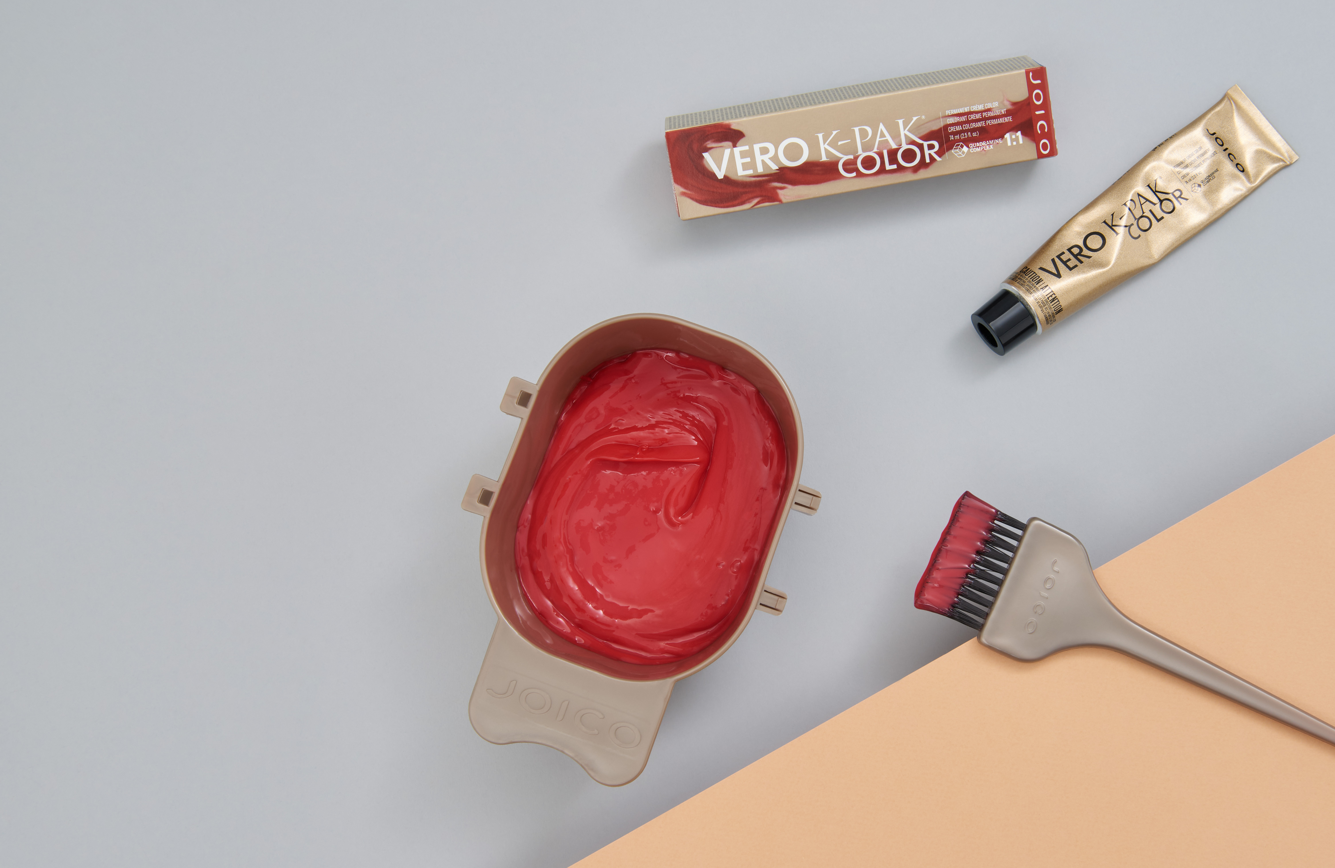

Workshop
“Some images can only be used for internal education purposes. These must not be copied or used in the public domain”

Slide 2
Mannequin heads:
Blonde level 10
Blonde level 8 Gold
Brunette level 5-6
Notes:
You can print these slides and hang up in the classroom

Slide 3
COLOR RULES
Divide each quadrant into 4.
You can choose to divide each quadrant into more, if you want to try more!
Use up to a maximum of 2 shades per formula (think simple).
Write down how to proceed and stick to the plan.
Remember:
Color + 10 Vol: processing time 30 min (35 for reds), mix 1:1!
Apply enough product!!!
Notes:
Print the papers for the participants.
1 mannequin head per participant or 1 mannequin head per 2

Slide 4
Assignment 1
QUADRANT 1
FORMULA 1: Vero K-Pak 4FV, 35 min
FORMULA 2: Vero K-Pak 5XR, 35 min
FORMULA 3: Vero K-Pak 4RV, 35 min
FORMULA 4: Vero K-Pak 6RC, 35 min
Level 10 Bleached blonde
QUADRANT 2
FORMULA 1: Vero K-Pak 10N, 30 min
FORMULA 2: Vero K-Pak 10A, 30 min
FORMULA 3: Vero K-Pak 9B, 30 min
FORMULA 4: Vero K-Pak 9BA, 30 min
F1
F1
1
2
QUADRANT 3
FORMULA 1: TSB, 20 min
FORMULA 2: TPB, 20 min
FORMULA 3: TBB, 20 min
FORMULA 4: 1/3 TSB + 1/3 TPB + 1/3 TBB, 20 min
F2
F2
F3
F3
F4
F4
F1
F1
QUADRANT 4
Formulas of choice
Consider trying out formulas with VeroGlaze (20 min)
F2
3
4
F2
F3
F3
F4
F4
EXTRA: add Intensifier to your formulas

Slide 5
NOTES

Slide 6
Assignment 2
QUADRANT 1
FORMULA 1: Vero K-Pak 6RC, 35 min
FORMULA 2: Vero K-Pak 5XR, 35 min
FORMULA 3: Vero K-Pak 4RV, 35 min
FORMULA 4: Vero K-Pak 8RG, 35 min
Level 8 Gold Blonde
QUADRANT 2
FORMULA 1: Vero K-Pak 8G, 35 min
FORMULA 2: Vero K-Pak 7B, 30 min
FORMULA 3: Vero K-Pak 7N, 30 min
FORMULA 4: Vero K-Pak 7BA, 30 min
F1
F1
1
2
QUADRANT 3
FORMULA 1: Vero K-Pak 8B, 30 min
FORMULA 2: Vero K-Pak 7B, 30 min
FORMULA 3: CHOOSE FORMULA, 30-35 min
FORMULA 4: CHOOSE FORMULA, 30-35 min
F2
F2
F3
F3
F4
F4
F1
F1
QUADRANT 4
Formulas of choice
Consider trying out formulas with VeroGlaze (20 min)
F2
3
4
F2
F3
F3
F4
F4
EXTRA: add Intensifier to your formulas

Slide 7
NOTES

Slide 8
Assignment 3
QUADRANT 1
FORMULA 1: Vero K-Pak 5RM, 35 min
FORMULA 2: Vero K-Pak 5XR, 35 min
FORMULA 3: Vero K-Pak 4RV, 35 min
FORMULA 4: Vero K-Pak 4FV, 35 min
Level 5 Warm Brown
QUADRANT 2
FORMULA 1: Vero K-Pak 4N, 30 min
FORMULA 2: Vero K-Pak 5G, 30 min
FORMULA 3: Vero K-Pak 5A, 30 min
FORMULA 4: CHOOSE FORMULA, 30-35 min
F1
F1
QUADRANT 3
FORMULA 1: Vero K-Pak 5B, 30 min
FORMULA 2: Vero K-Pak ½ 5XR + ½ 4N, 30 min
FORMULA 3: Vero K-Pak 4VR, 30 min
FORMULA 4: CHOOSE FORMULA, 30-35 min
1
2
F2
F2
F3
F3
F4
F4
F1
F1
QUADRANT 4
Formulas of choice
Consider trying out formulas with VeroGlaze (20 min)
F2
3
4
F2
F3
F3
F4
F4
EXTRA: add Intensifier to your formulas

Slide 9
NOTES

