Slide 1

HOMEWORK
Module 3:
Corrective Color

Slide 2
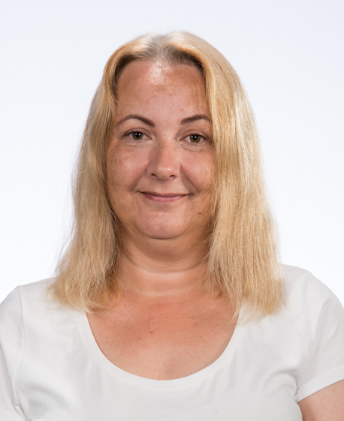
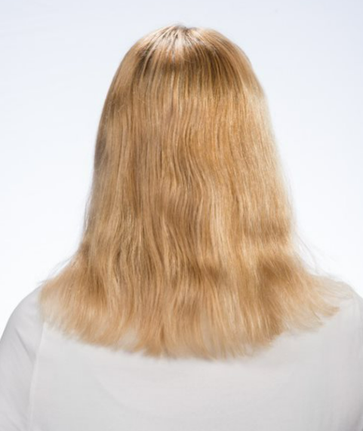
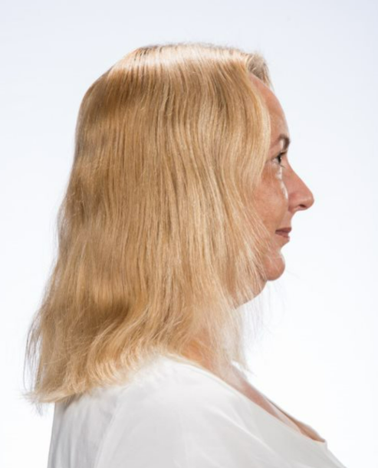

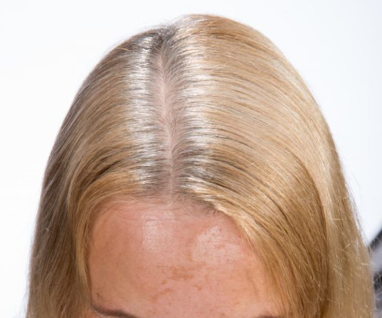
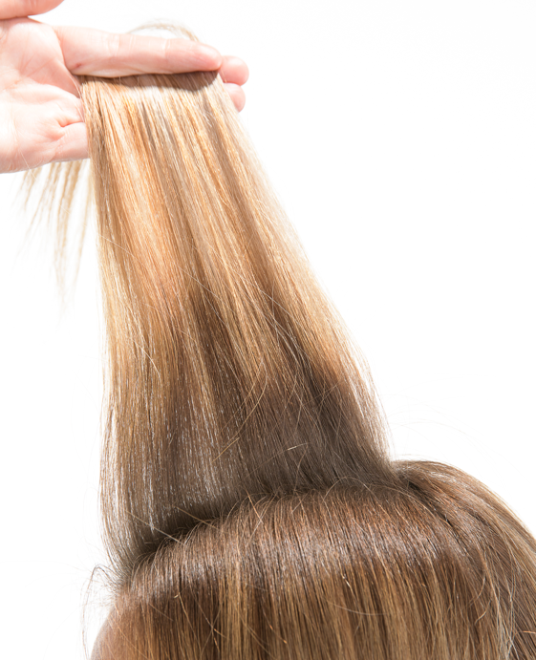
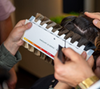
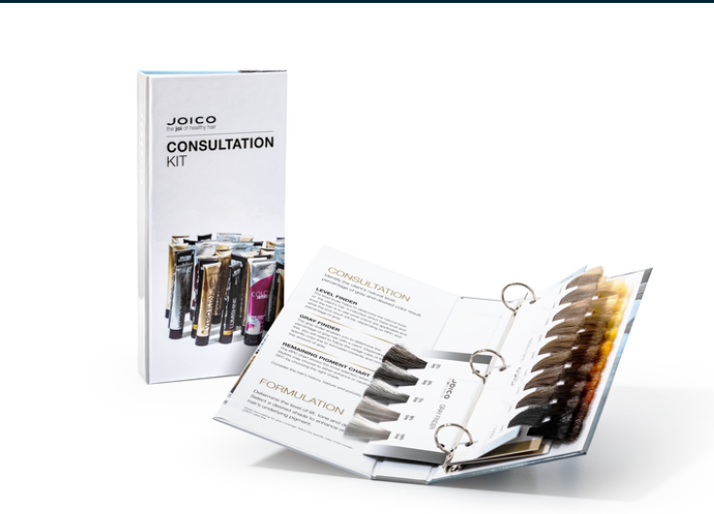
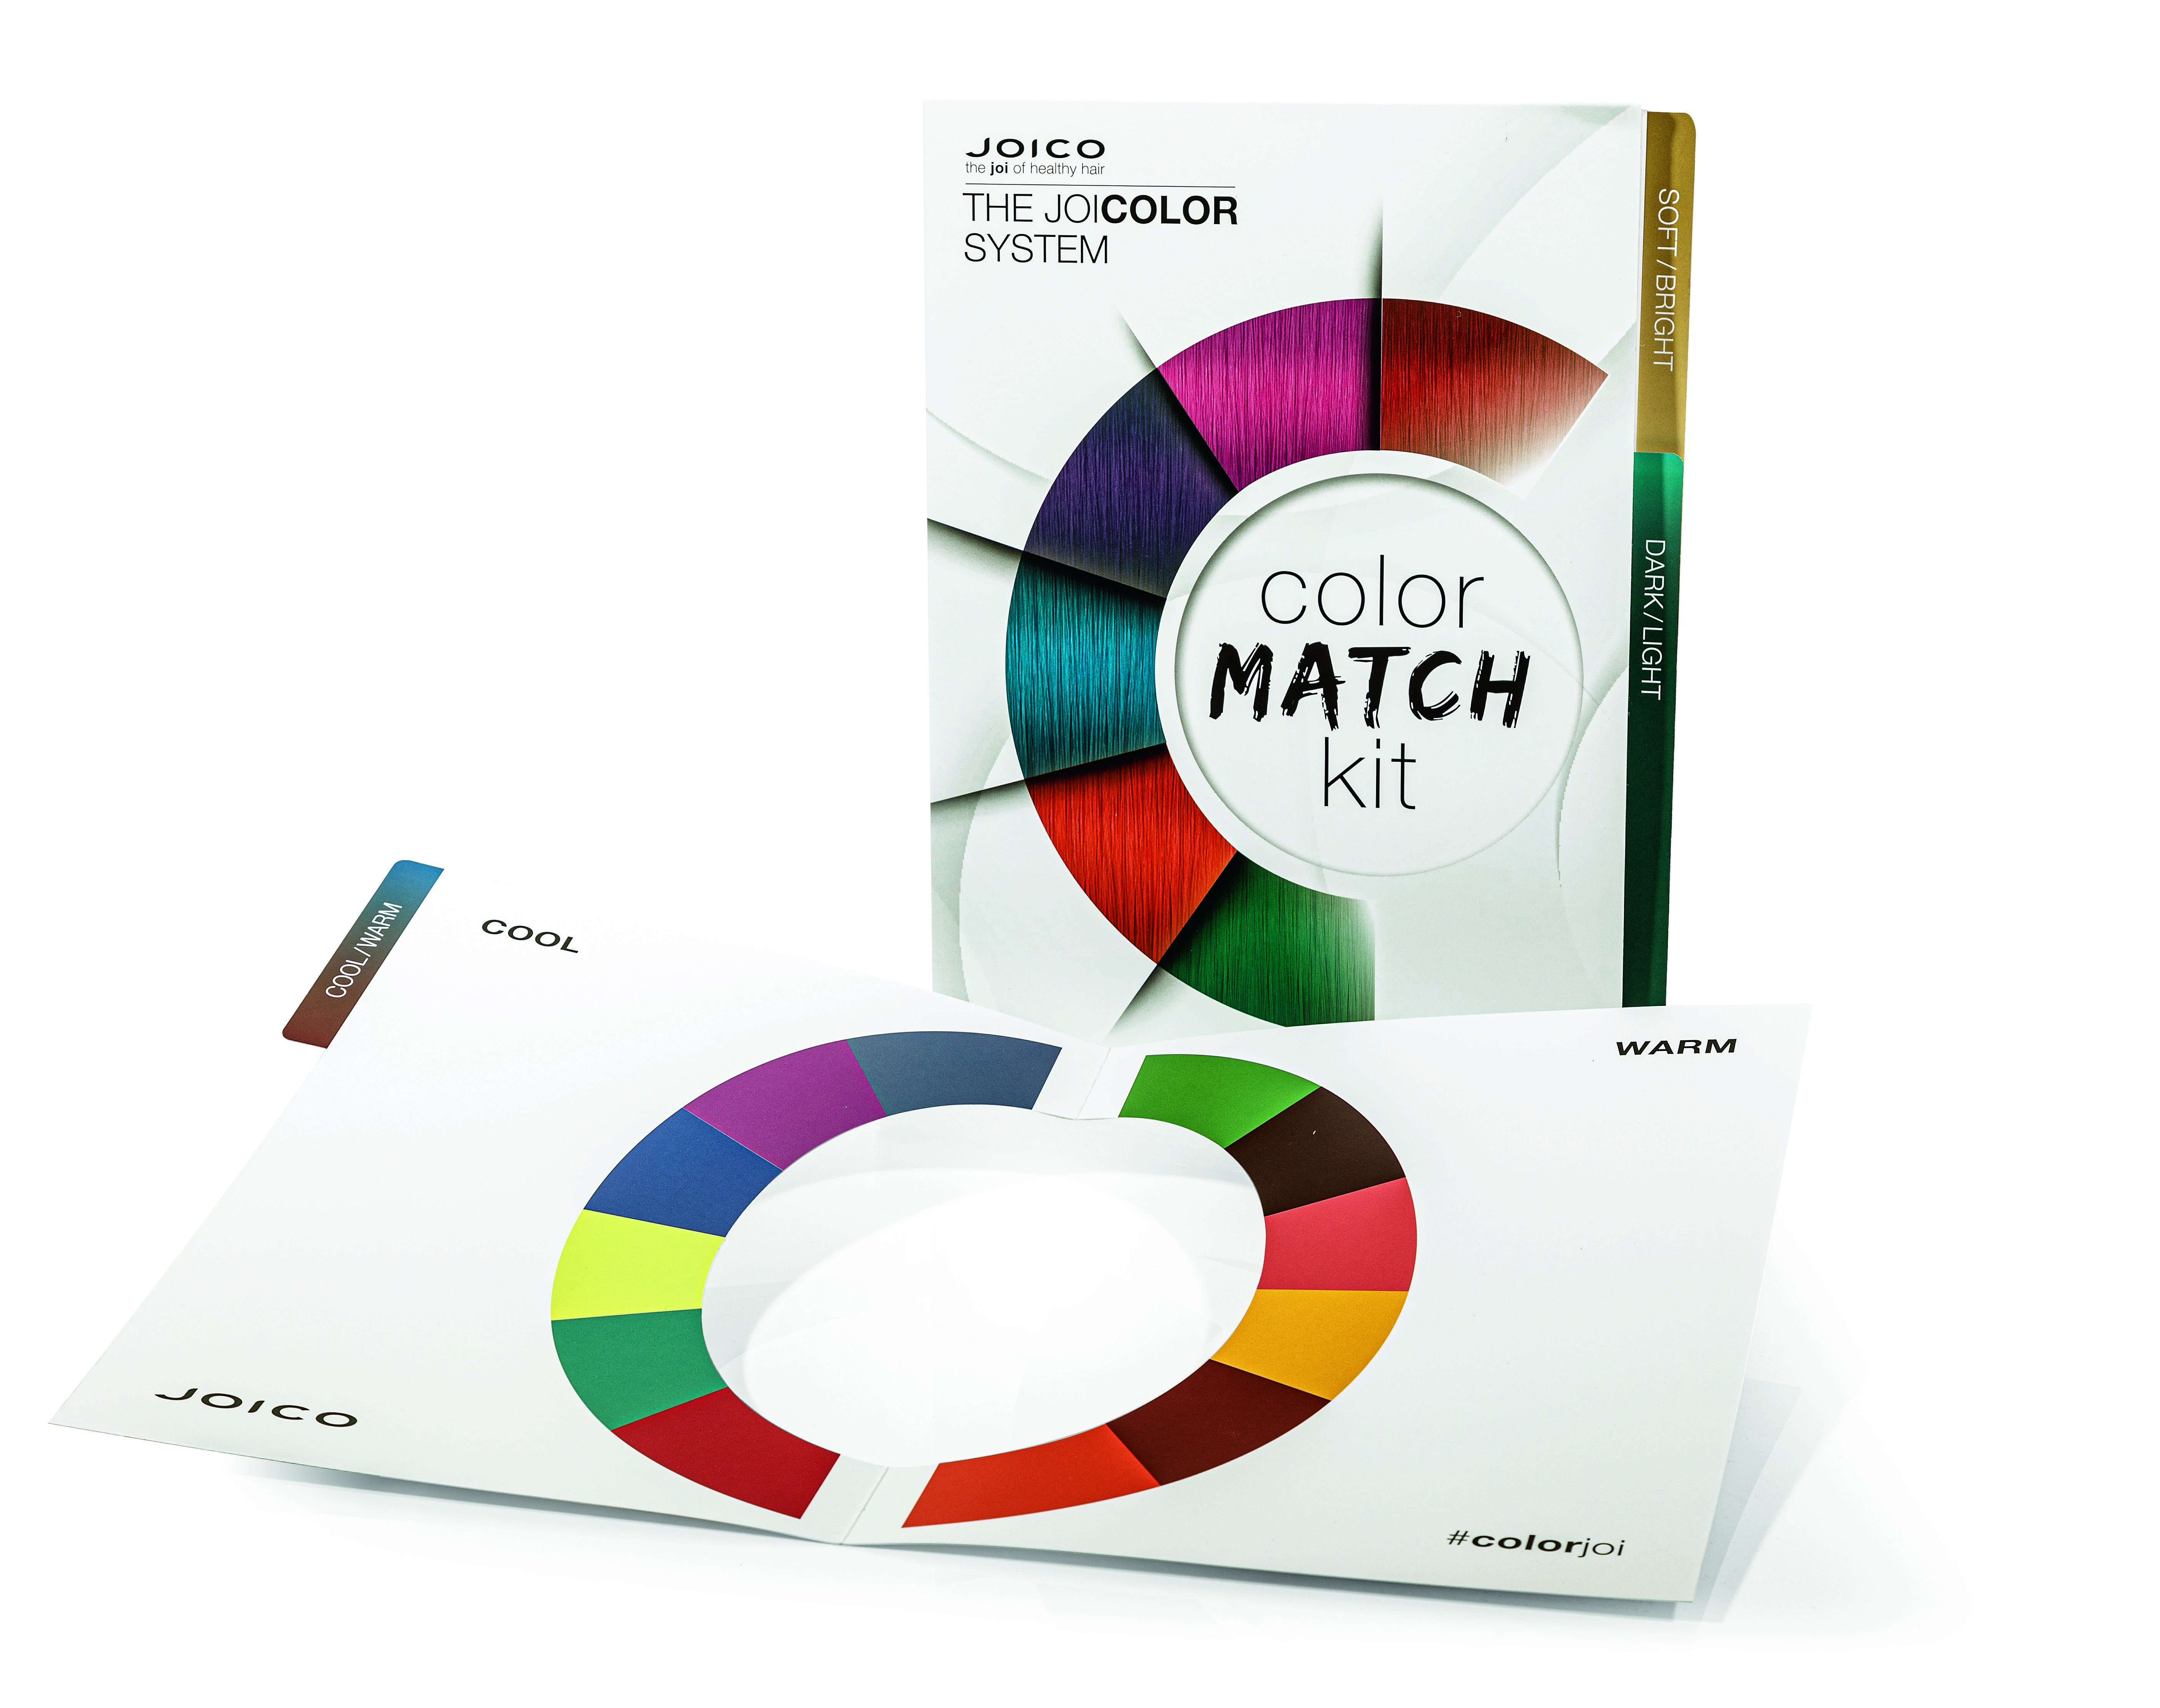
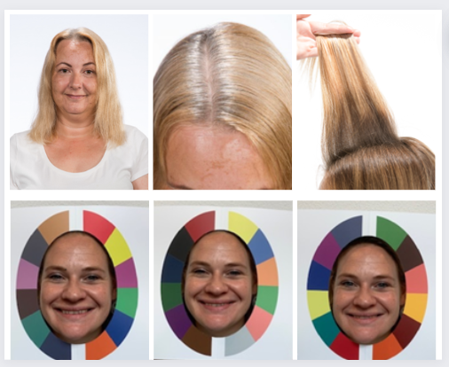
Create a beautiful before and after on a live model. This needs to be a corrective color technique: - From light to dark - From dark to light Take a before picture/ movie of your model using daylight - Front, back and side
2. Complete the consultation & diagnose process: - Natural level (regrowth) - Grey percentage - Level of lengths & ends Take a picture/ movie using daylight
3. Use the JOICO Color Match Kit to determine: - Cool ↔ Warm - Dark ↔ Light - Soft ↔ Bright Take a picture of each with model using daylight

Slide 3
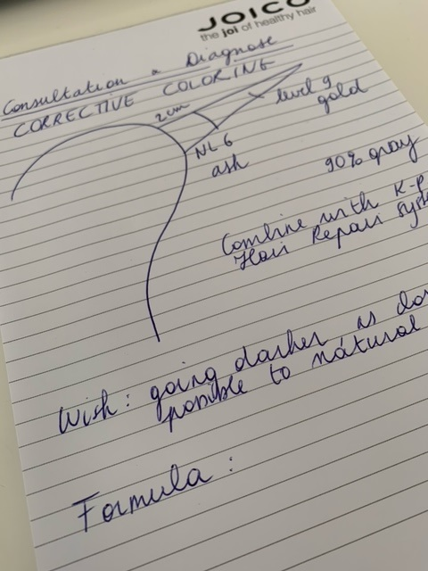

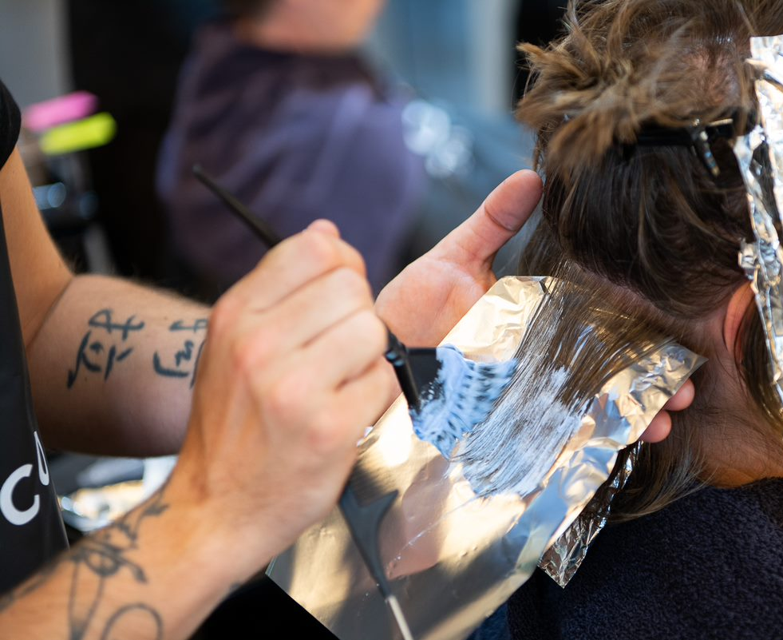
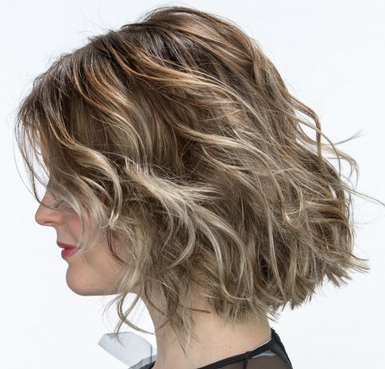
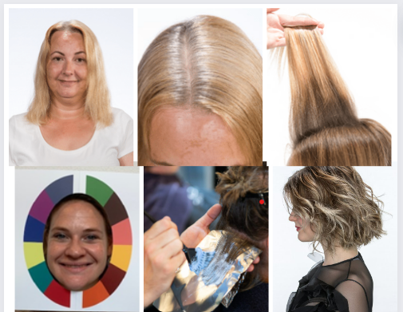
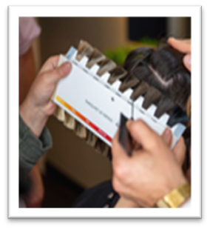
4. Execute the color process Write down all the steps and used formulas Take pictures/ short movies of these different steps + final result ☺ | Some examples:
5. Create a collage, a REEL, a video, …. with all the pictures, movies you have BE as creative as possible!!! ☺

Slide 4
6. Explain in a short summary or include into your collage, REEL, video,… - Consultation & Diagnose - All different steps to come to the final result - Used product formulas - Share your experiences What was challenging? What went easy? | NL 6 90% gray L & E level 8 – 9 – 10 gold Bright – Light - Cool Pre-lightening in foils until level 10 Blonde Life 10Vol 1+2 K-Pak Hair Repair System Toning Blonde Life Quick Toners …. Healthy, shiny hair Easy lift Foiling technique back-to-back Very quick toning result …
7. Send your collage, REEL, video, … (via email, Whatsapp, Facebook…)

