Slide 1
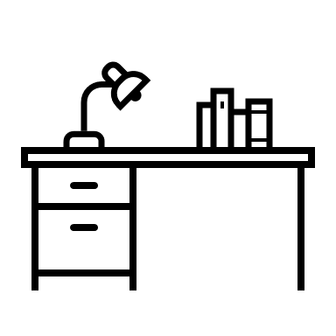
HOMEWORK
Module 1:
Consultation & Diagnose

Slide 2
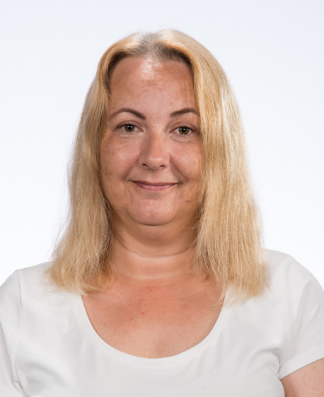

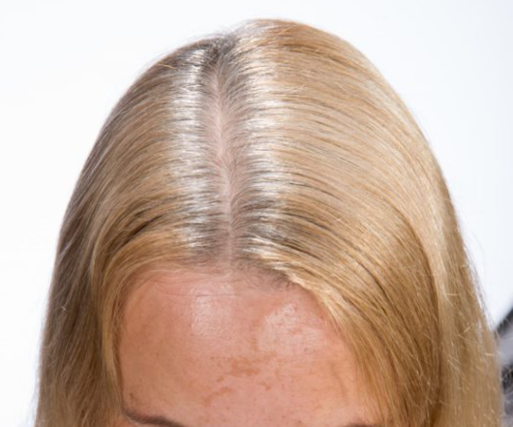
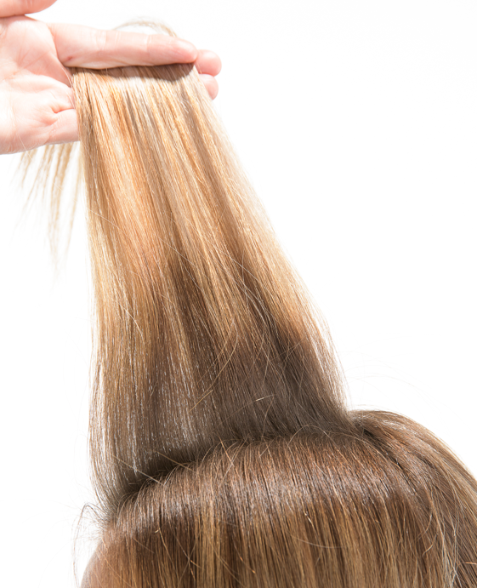
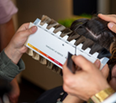
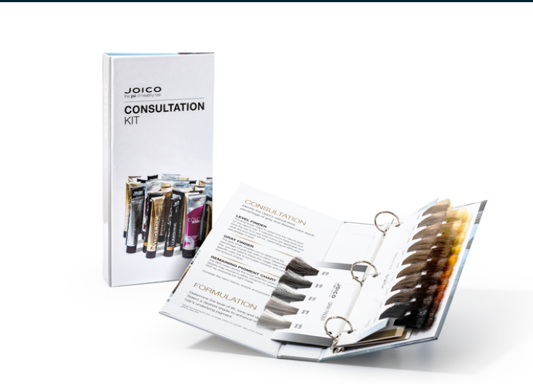
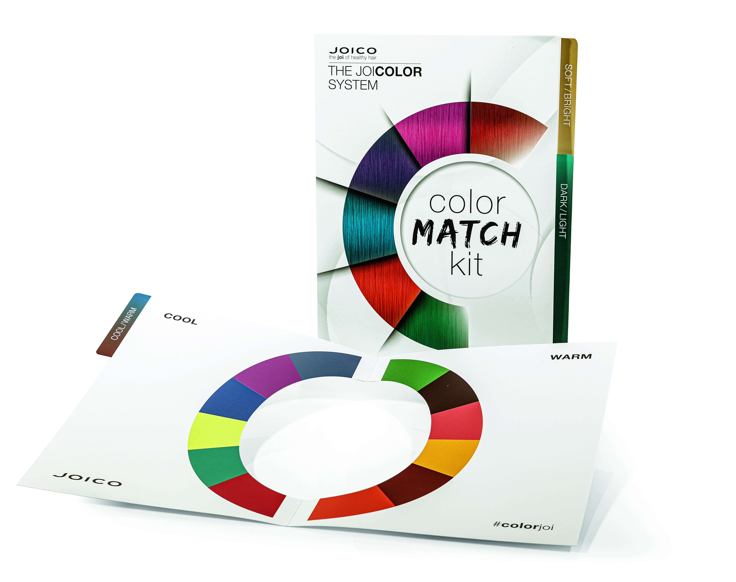
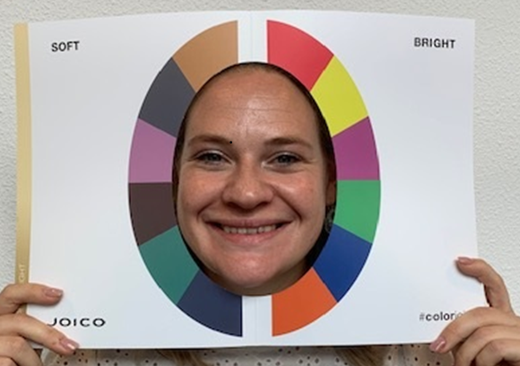
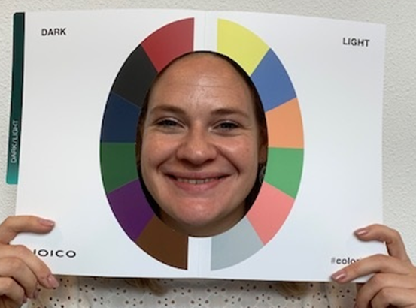
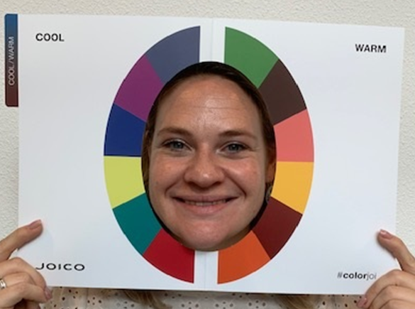
Take a front picture of a colleague, friend, family using daylight | Some examples:
2. Use the JOICO Consultation Kit to determine: - Natural level (regrowth) - Grey percentage - Level of lengths & ends Take a picture using daylight
3. Use the JOICO Color Match Kit to determine: - Cool ↔ Warm - Dark ↔ Light - Soft ↔ Bright Take a picture of each with model using daylight

Slide 3
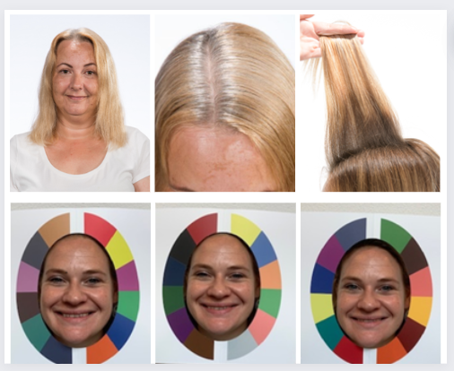
4. Create a collage with all pictures (with Fotojet, Canva, Fotor for example)
5. Explain in a short summary: - Natural level (regrowth) - Grey percentage - Level & tone of lengths & ends - The 3 types discovered with the JOICO Color Match Kit - 2 tips/ topics to have the perfect end result | NL 6 90% gray L & E level 8 – 9 – 10 gold Bright – Light - Cool Apply enough product & against the cuticle
6. Send your collage + summary (via email, Whatsapp, Facebook…)

